Slide 1
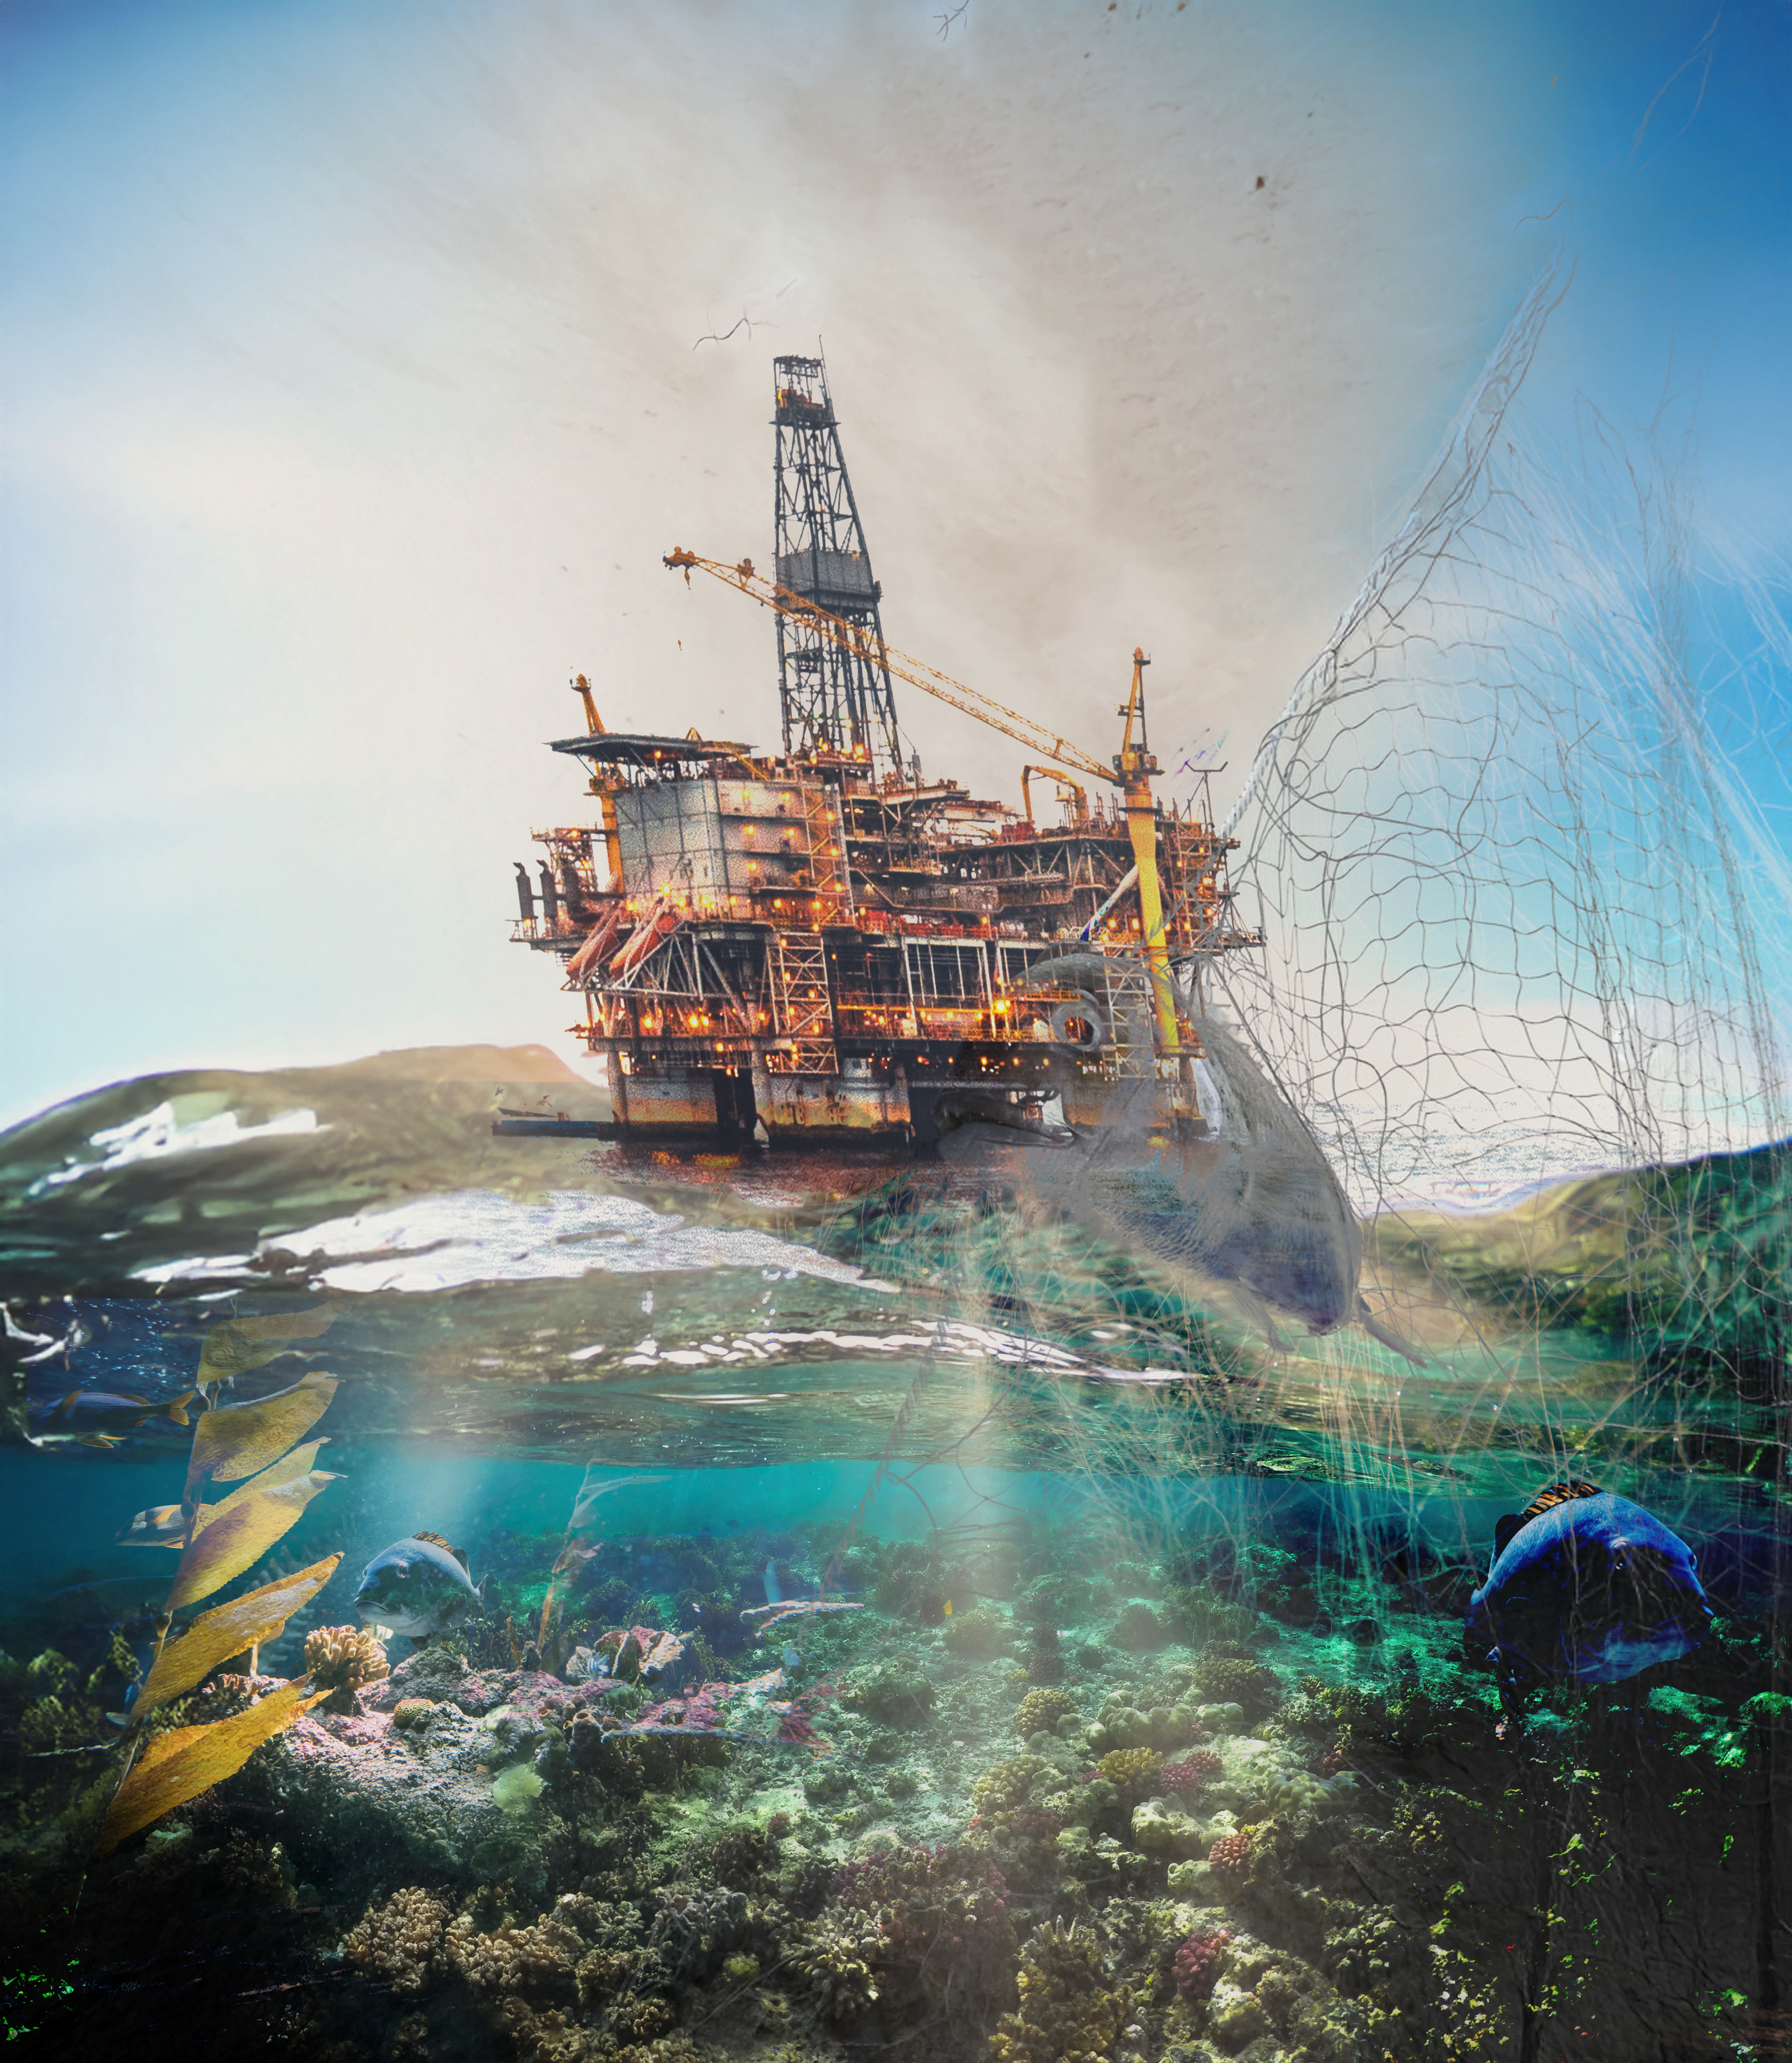
Oceans 5
International funders’ collaborative dedicated to addressing the largest threats to ocean health and the highest priorities identified by scientists:
  Stopping overfishing and combatting illegal and unregulated fishing
  Establishing protected areas and other effective conservation measures
  Constraining offshore oil and gas development
Notes:
As a Funders collaborative
Activities directed by its Board of Advisors, a group of 23 of the world’s leading marine philanthropic institutions.
Issue discussion among funders & strategy building
Co-funding with external collaborations – approx. 27% of our projects co-funded in 2024
Biggest area of support is Protected areas (30by30 imperative and political momentum)
We are staffed by a small group of seasoned professionals in 8 countries with local and regional expertise.

Slide 2
Oceans 5 Approach
Policy-oriented outcomes from governments
Outcomes that are “globally significant”, typically in areas that are underserved by marine philanthropy
Non-governmental organization actions across the globe, currently in over 100 countries
Notes:
Since its founding in 2011, Oceans 5 has provided over $XXX million in grants to XX organisations in XXX countries.
Oceans 5 grantees have a remarkable record of accomplishment, having been instrumental in many of the most successful ocean conservation initiatives of the past decade. Our grantees helped secure protections for nearly 8 million square kilometers of ocean waters, which when added together is about the size of Australia. They’ve strategically blocked imports of illegal and unmanaged seafood products to three of the world’s four largest markets, effectively leveraging policy reforms in dozens of the world’s most powerful fishing nations which seek access to those markets. Grantees also have secured lasting reforms to fisheries policies in about two dozen countries and international management bodies, including fishing restrictions in areas beyond national jurisdiction.
Oceans 5 works closely with local civil society and indigenous organizations to design collaborative projects and campaigns that are uniquely suited to influence government decisions through proven techniques such advocacy, research, communications, and capacity building. The Board is inspired by projects that are globally significant, particularly if they provide tangible and lasting benefits to coastal communities and the world’s oceans. Oceans 5 prefers time-bound projects involving multiple organizations working toward common policy objectives.

Slide 3
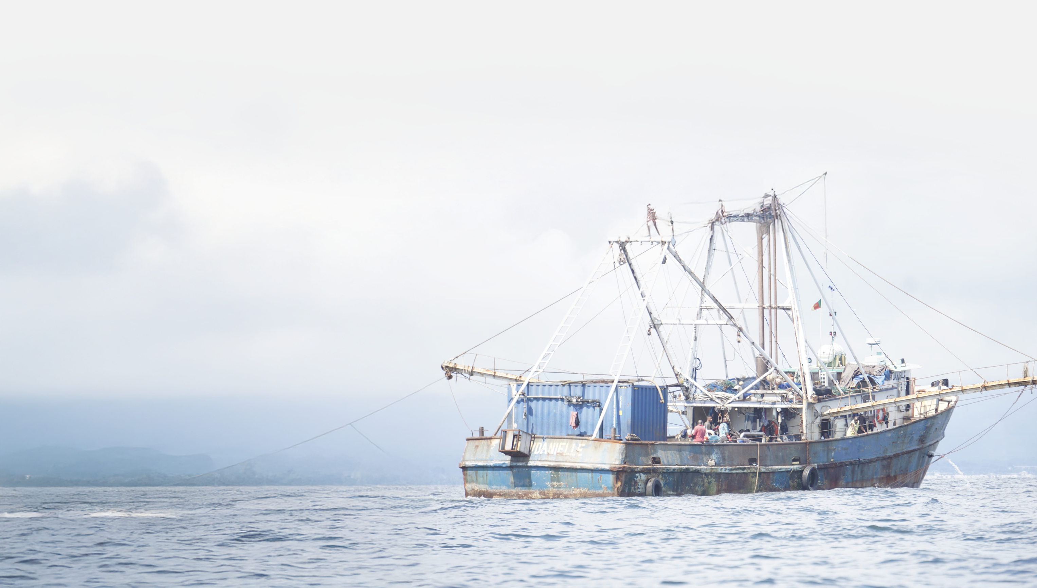
Oceans 5 Grantee Highlights
Stopping Overfishing
Notes:
Multiple grantees have implemented a range of different approaches including enacting national laws and policies, eliminating destructive fishing practices and supporting best practices like collecting data, issuing licences or restricting unsustainable harvests

Slide 4
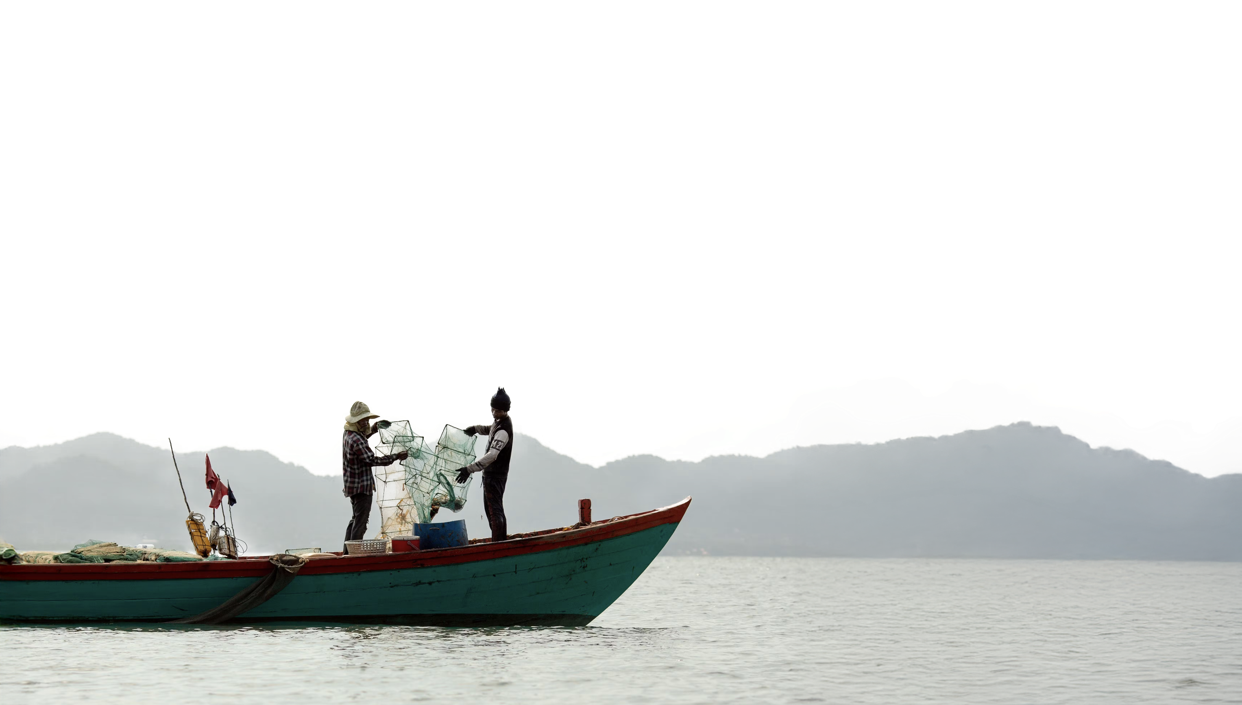
Oceans 5 Grantee Highlights
Combatting IUU fishing
Notes:
Many governments focus on the “illegal” portion of IUU fishing, while controlling the “unregulated” and “unreported” is arguably more important to helping coastal communities. Our portfolio focused on leveraging the largest seafood markets to prevent IUU imports, while also working in countries with the largest distant water fleets.
Over the years, our grantees succeed in supporting new laws, regulations and policies in the European Union, United States, Japan, China, Korea, Taiwan, and at several regional fisheries management organizations (RFMOs). Increasing accomplishments in West Africa.
Promoting Global fisheries transparency: Global Fishing Watch, Coalition for Fisheries Transparency

Slide 5
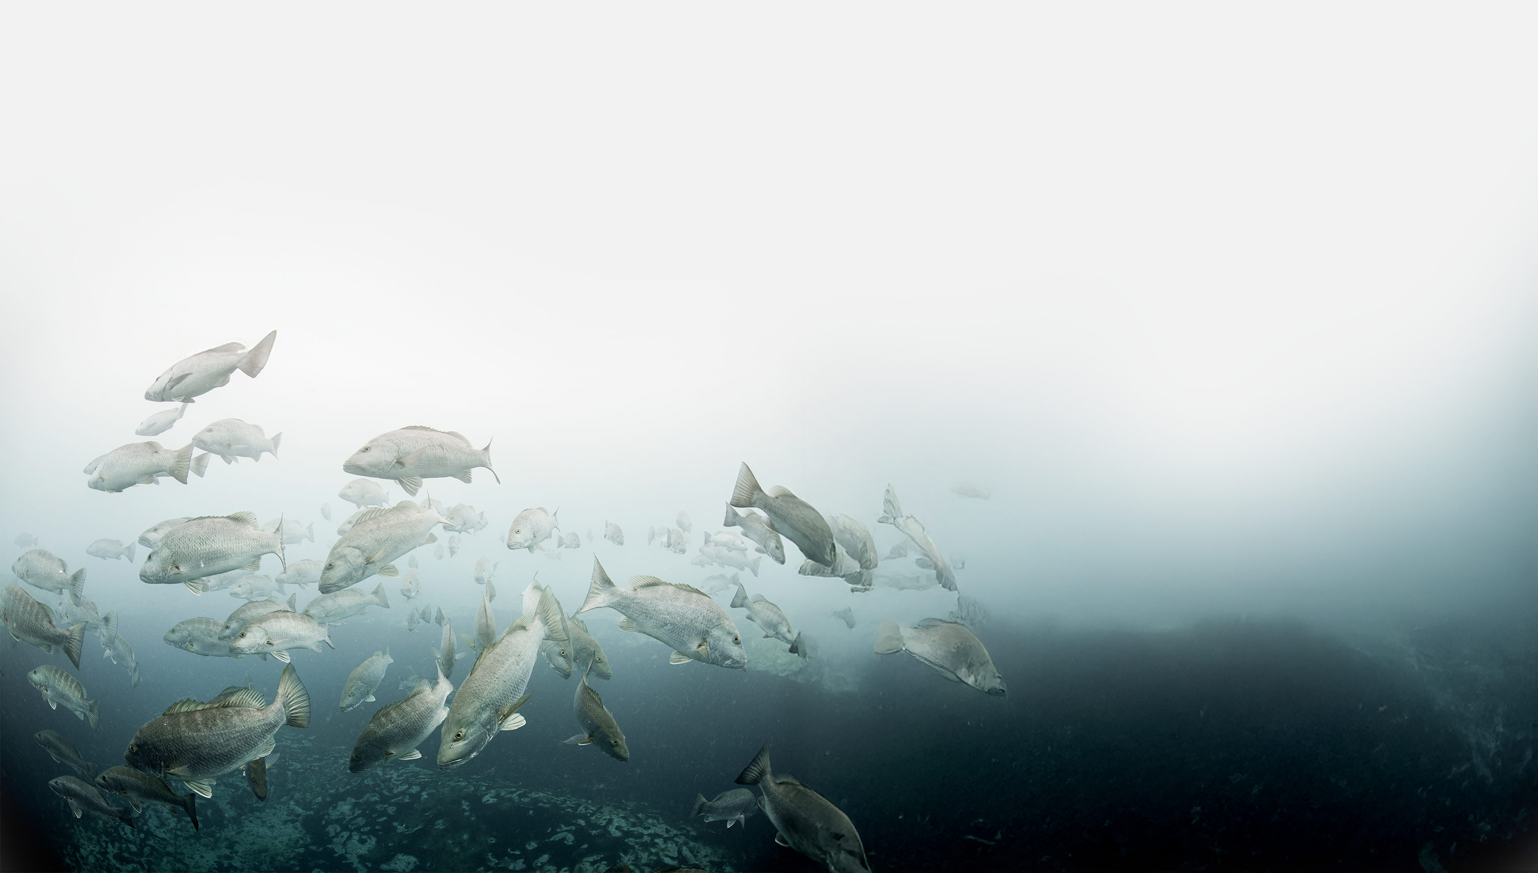
Oceans 5 Grantee Highlights
Establishing protected areas
Notes:
We focused on huge opportunities in our early years, particularly in the expansive island territories of the Pacific. Our grantees were mostly national-level groups that worked closely with traditional leaders. Large, strongly protected areas were established in Palau, Kiribati, Niue, United States’ Remote Islands, Hawaii, and Tonga. Smaller protected areas were established in the Federated States of Micronesia, Solomons Island and Papua New Guinea. Our portfolio also included several prominent successes in Latin America, including Argentina, Chile, and Mexico; and, in the Arctic, particularly Russia, Canada, and Alaska. In recent years, our grants have focused on smaller areas, often adjacent to more densely populated areas, with significant success in South Africa, the Mediterranean and several European Member States.
Increasingly we are identifying and supporting national level 30by30 implementation including in South Korea, Indonesia, Japan, the Philippines, Timor Leste, etc

Slide 6
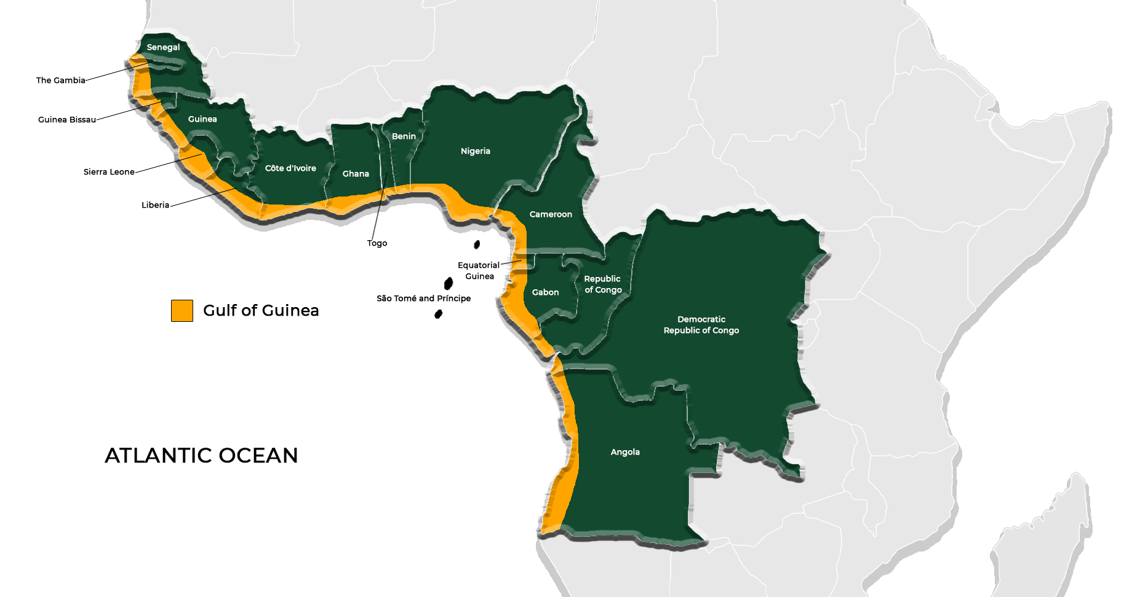
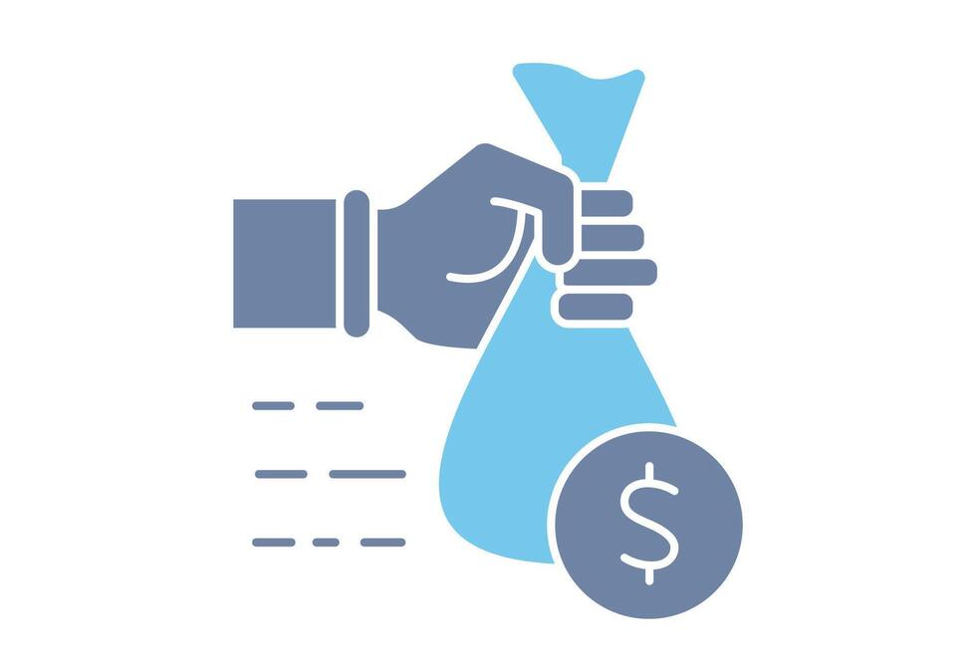
15 Grants in
10 countries of the Gulf of Guinea
MPAs
IUU fishing &transparency policies
Fisheries govrnance
3

Slide 7
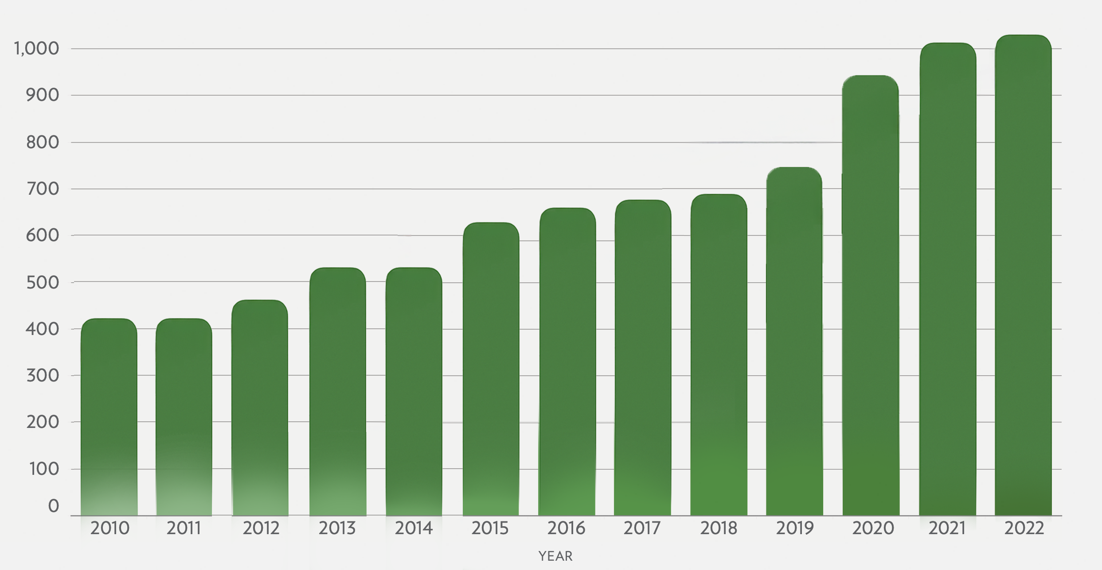
Philanthropy in Ocean Action
Philanthropic Ocean-Related
Grantmaking, 2010-2022 (US)
Ocean Funding From Philanthropy and NGO Non-Foundation Sources: Estimated USD 1.4-2.8B
<1%
USD
811B
ANNUAL FUNDING (USD. MILLIONS)
Global Philanthropic Funding
Ocean Conservation Funding
Note: The year 2021 is the most recent year for which complete data is available for ODA funding levels.
Our Shared Seas. “Funding Trends 2023: Tracking the State of Global Ocean Funding.” 2023. www.oursharedseas.com/funding.
Notes:
Ocean covers 70% of the planet and blue economy contributes US1.5 trillion to the global economy annually. But receives less than 1 percent of global philanthropic funding. Generally SDG 14 is the least funded area of action of all the SDGs
Philanthropic funding for marine conservation more than doubled over the past 13 years, from USD 430 million in 2010 to USD 1.0 billion in 2022. The top three areas of funding – Science initiatives, Fisheries and aquaculture, and Protected areas and Habitat protection – continue to reflect the core priorities of the marine conservation sector.
Philanthropic investment in the ocean-climate nexus is one of the most striking sectoral trends in recent years. Philanthropy and civil society have catalyzed engagement across key issues—expanding offshore wind, decarbonizing shipping, supporting coastal resilience and adaptation efforts, and more. Still, this area remains ripe with opportunity for continued investment and alignment given the ocean’s role as an essential source of ocean-climate solutions.

Slide 8
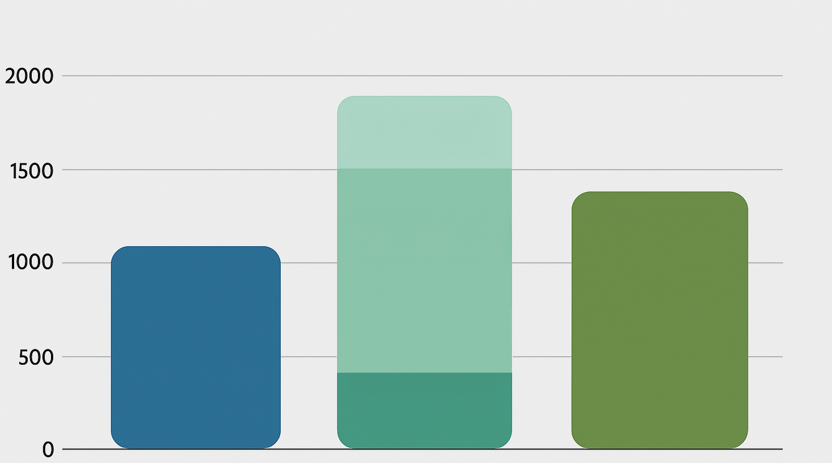
Financing Ocean Action
High
Estimate
Medium
Estimate
USD, MILLIONS
Low
Estimate
NGO, NON-FOUNDATION
(2022)
OFFICIAL DEVELOPMENT
ASSISTANCE (2021)
PHILANTHROPIC
(2022)
Note: The year 2021 is the most recent year for which complete data is available for ODA funding levels.
Our Shared Seas. “Funding Trends 2023: Tracking the State of Global Ocean Funding.” 2023. www.oursharedseas.com/funding.
Notes:
This shows the annual ocean funding from respective sectors in USD from the same study and is based on the 2021-2022 figures. The estimates for ODA funding levels were sourced from OECD.
Combined these three sectors provide roughly UD 3.3 billion annually to ocean conservation initiatives globally.
A study from the UNEP in XXX, it is estimated that annually USD 9-12 billion per year is needed to protect 30% of the ocean, the collective target agreed by government through the Kunming – Montreal Global Biodiveristy Framework back in 2021. This is 9-12 times greater than current spending on marine protected areas globally alone, not accounting for other issues such as fisheries, climate-ocean action etc.
Recent reports suggest that $175 billion per year is needed to achieve SDG14 by 2030
Not just about numbers as (public) funds can be misdirected towards harmful subsidies such as overcapacity of fishing fleets or oil and gas projects

Slide 9

Recent Developments for Ocean Action
Joint 30x30 Funding Initiative
Ocean Resilience & Climate Alliance
High Seas Pledge
Joint 30by30 Funding Initiative
Ocean Resilience & Climate Alliance
High Seas Pledge
Notes:
Part of the bigger picture. Philanthropy’s role
Joint 30x30 Funding Initiative: Bloomberg and Arcadia luanhced a new fund to help secure protection for 30 percent of the world’s ocean by 2030, as outlined by Target 3 of the KMGBF. Launched at the 2023 Our Ocean Conference, the fund focuses on supporting the ambitons of indigenious peoples, coastal communtiies, NGOs and governments to strengthen the health and resilience of the ocean
Ocean Resilience & Climate Alliance is a new philanthropic initiative that identifies and funds ocean-climate solutions across mitigation, sequestration, adaptation and resilience. First launched at UNFCCC COP28 in 2023, and pledged $300 million million at OOC in Greence last year. This year, ORCA continues to gain momentum towards ocean-climate action as it increased its commitment to $370 million USD from more than 20 donors which (was announced?) here in Busan
High Seas Pledge was announced on CBD COP16’s Finance Day to highlight the critical role of protecting the high seas to achived 30x30 for the ocean, which is cornerstone to achieving the KMGBF. A group of leading philanthropies commited $51.6 million USD to help accelerate the creation of MPAs in the high seas through funding initiatives, with focus on the Global South leadership, such as providing technical, scientific and stakeholder engagement in partnership with governments to advance high seas MPA proposals.

