Slide 1
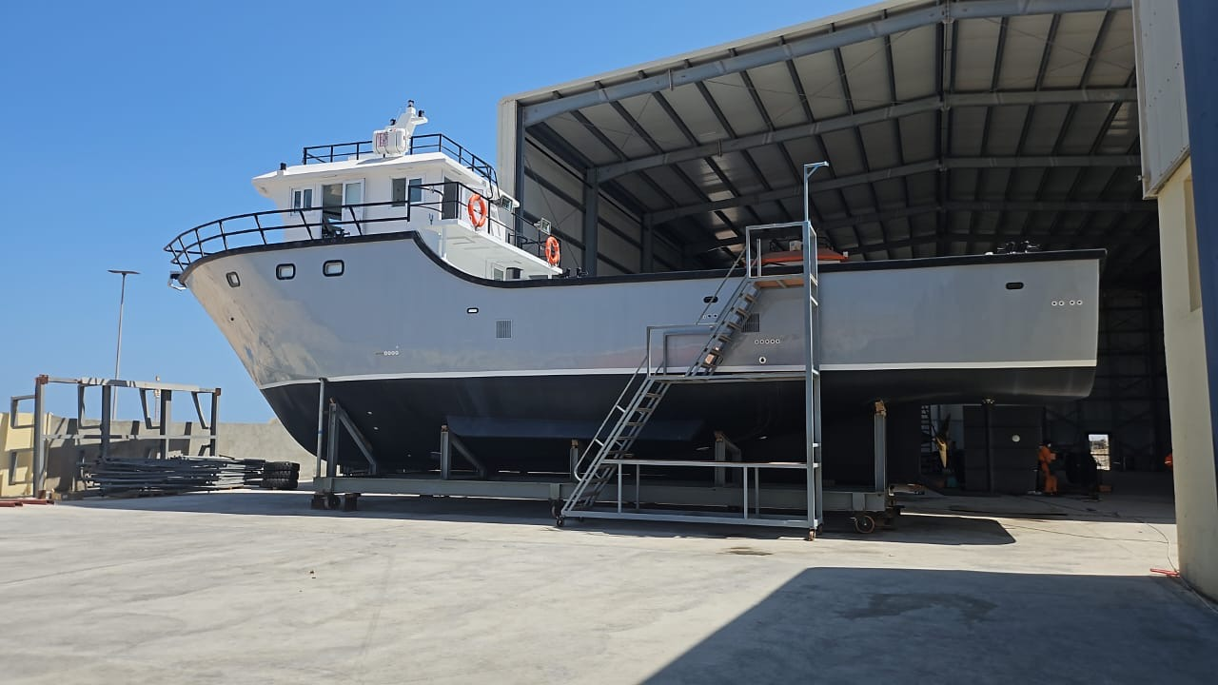
Maritime Safety, Security, and Governance of the Blue Economy
Add an event
Write a description of the significance of this event
Add an event
Write a description of the significance of this event
Add an event
Write a description of the significance of this event
Add an event
Write a description of the significance of this event
Add an event
Write a description of the significance of this event
Liberia’s First Fiberglass Boat

Slide 2
Introduction
- The ocean is a driver of economic growth, livelihoods, and ecological balance.
- The "Blue Economy" focuses on sustainable use of marine resources.
- Effective governance ensures safety, security, and equitable resource use.
- Liberia, as a coastal nation, has critical stakes in maritime governance.

Slide 3
What is the Blue Economy?
- Definition: Sustainable use of ocean resources for economic growth, improved livelihoods, and jobs, while preserving ocean ecosystem health.
- Sectors:
• Fisheries & Aquaculture
• Maritime Transport
• Coastal Tourism
• Renewable Energy
• Marine Biotechnology

Slide 4
Maritime Safety and Security: Why It Matters
- Prevents illegal, unreported and unregulated (IUU) fishing
- Protects national borders and trade routes
- Reduces marine pollution and piracy
- Enables safe navigation and rescue at sea
- Promotes investor confidence in coastal development

Slide 5
Governance in the Blue Economy
- Legal Frameworks: UNCLOS, IMO regulations, regional agreements
- Institutions: National maritime authorities, navies, regional fisheries bodies
- Policies: National Ocean Strategies, Marine Spatial Planning
- Stakeholders: Governments, private sector, communities, civil society

Slide 6
Liberia’s fishing efforts
26 Purse Seiners and 11 support vessels targeting tuna and tuna-like species.
6 Trawlers targeting demersal species.
5648 small-scale vessels targeting both pelagic and demersal species.

Slide 7
Efforts Made by Liberia to enhance Maritime Security
Ratified the BBNJ
Joined the FiTI
Endorsed tha Global Charter for Fisheries Transparency
WTO Bill on Fisheries Subsidies submited to Parliament

Slide 8
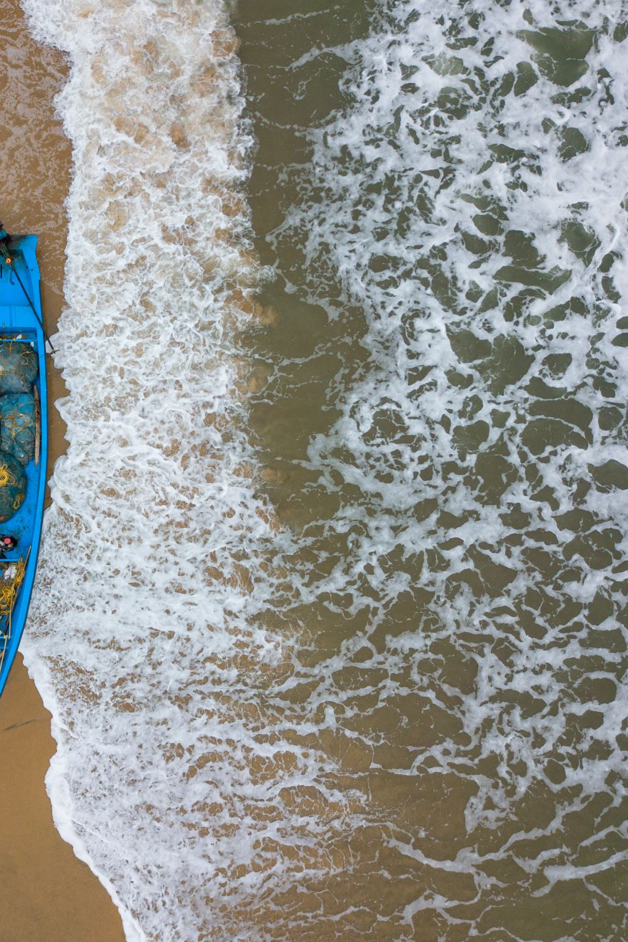
Liberia’s Maritime Profile
- Coastline: 579 km along the Atlantic Ocean
- Exclusive Economic Zone (EEZ): 200 NM
- Coastal Communities: Over 300,000 people depend on fisheries
- Challenges: IUU fishing, limited enforcement capacity, marine litter, weak coordination

Slide 9
Liberia’s Maritime Institutions
- NaFAA: Fisheries and aquaculture governance
- LiMA: Maritime administration, vessel registration
- Coast Guard: Maritime patrol, security, and law enforcement
- EPA: Environmental monitoring and protection
- NPA: Port authority operations

Slide 10
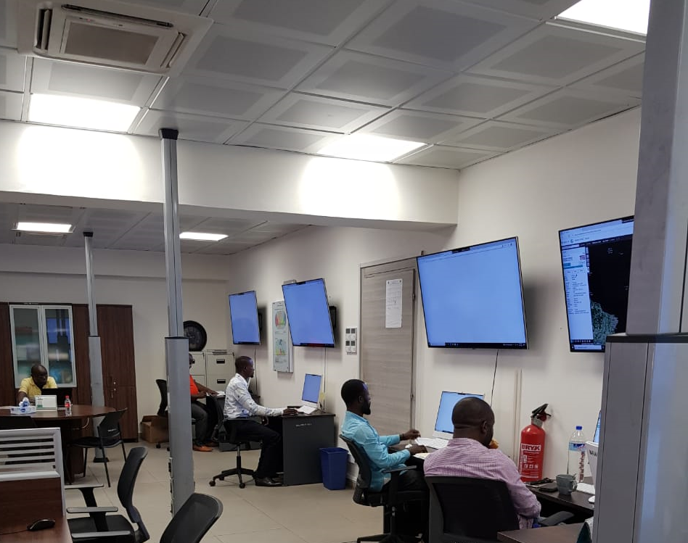
Strengthening MCS

Slide 11
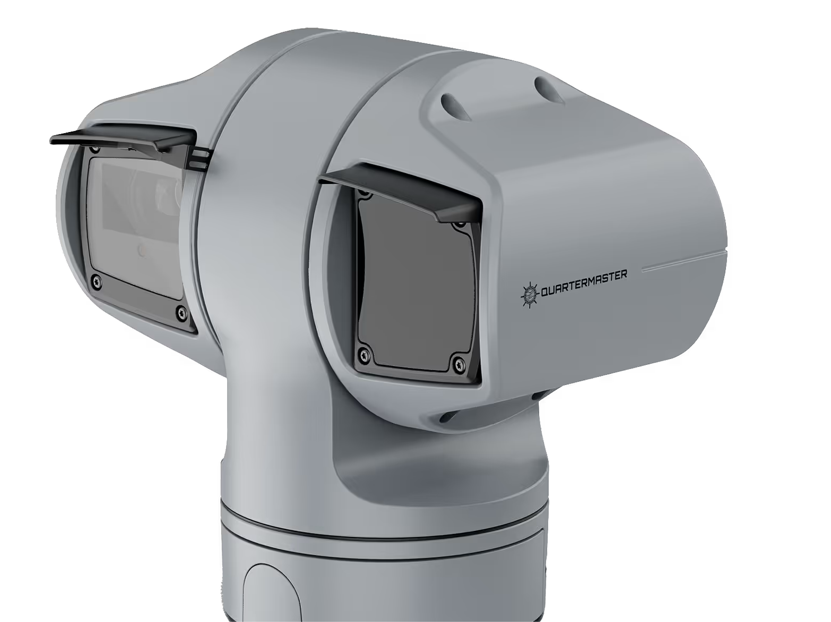
Strengthening MCS
High-definition video & imagery
Unparalleled situational awareness with crystal-clear visuals. The optical and infrared camera array offers 360° rotation and a 31x zoom for detailed video and image capture, day or night, housed within a rugged IP68-rated enclosure.

Slide 12
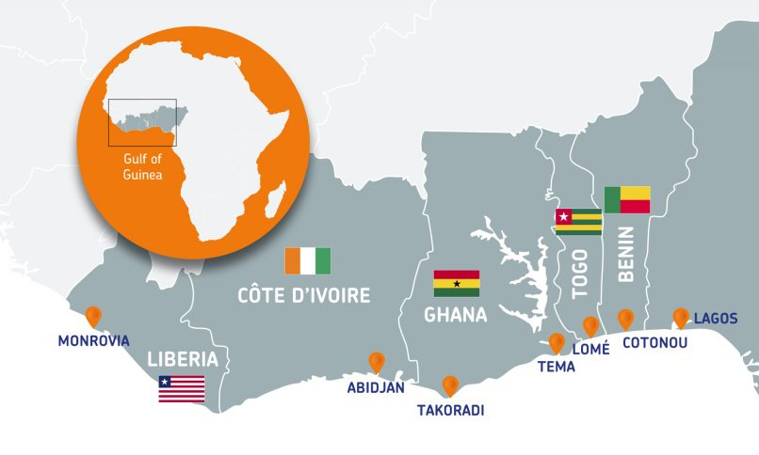
FCWC

Slide 13
Regional Cooperation: The FCWC Model
- FCWC = Fisheries Committee for the West Central Gulf of Guinea
- Member States: Liberia, Côte d’Ivoire, Ghana, Togo, Benin, Nigeria
- Objectives:
• Promote regional fisheries governance
• Strengthen MCS (Monitoring, Control, Surveillance)
• Coordinate responses to IUU fishing
• Share information and capacity building
- Achievements: Regional VMS, intelligence sharing, Joint Patrols

Slide 14
How FCWC Enhances Governance and Security
- Information Exchange: Regional dashboard, RFIMS
- Joint Monitoring: Multinational surveillance operations
- Legal Support: Regional harmonization of fisheries laws
- Capacity Building: Training, policy dialogues, national strategy development

Slide 15
Benefits for Member Countries
- Improved MCS through shared platforms
- Joint patrols reduce IUU fishing risk
- Data and intelligence sharing
- Capacity development for national officers
- Regional solidarity and donor engagement

Slide 16
Recommendations for the Gulf of Guinea
1. Strengthen regional coordination using the FCWC model by adapting improved technologies
1
2. Domesticate FCWC Tools: Adopt RFIMS and regional VMS fully
2
3. Invest in Capacity & Equipment: Vessels, satellite tools, training
3
4. Promote Ocean Governance Policy: Cross-sector ocean strategy
4
5. Engage Fishing Communities: Build awareness and accountability
5

Slide 17
Conclusion
- Maritime safety and security are central to the member states economy potential.
- Good governance backed by regional cooperation through FCWC and other regional bodies offers a tested pathway.
- With strategic investment and coordination, we can lead in sustainable ocean management in Africa.

Slide 18
Questions & Discussion

