Slide 1
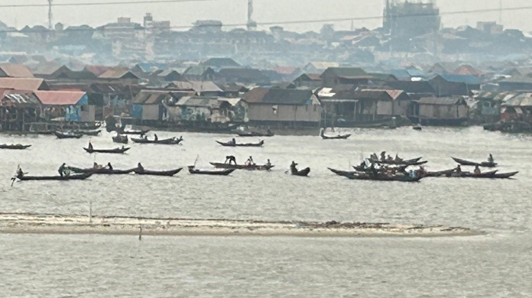
Enabling conditions and success factors for sustainable blue economies
Finance, innovation and partnership
Masanori Kobayashi, Senior Research Fellow, Sasakawa Peace Foundation
10 July 2025
© Ian Urbina
Notes:
koba
1

Slide 3
Sustainable Blue Economies
Ocean conservation and sustainable use of marine resources for economic promotion sustainable development – undertakings around the world
Key factors for promoting sustainable blue economies/ocean economy
(1) Co-benefit approach
(2) Optimizing tradeoffs
(3) Promoting stakeholder and social collaboration
Key words are social collaboration, innovation and international partnership

Slide 4
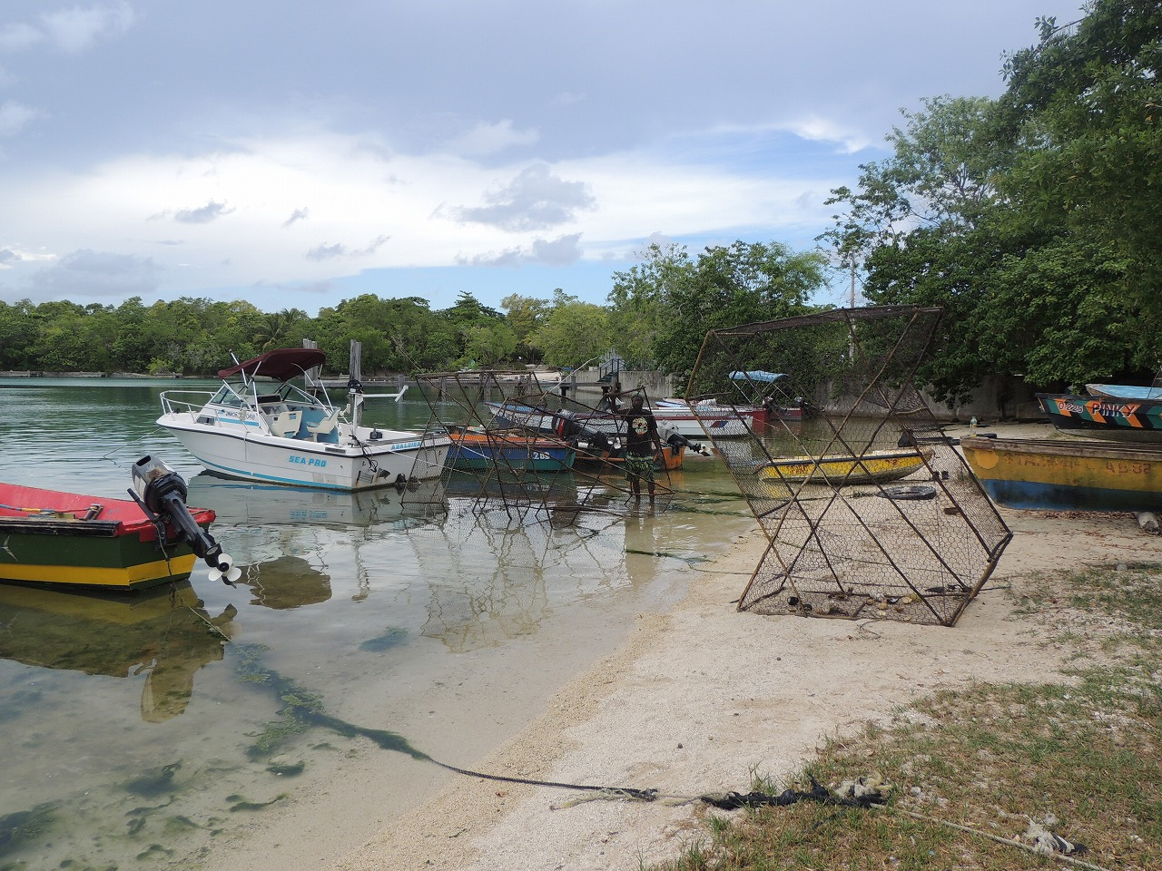
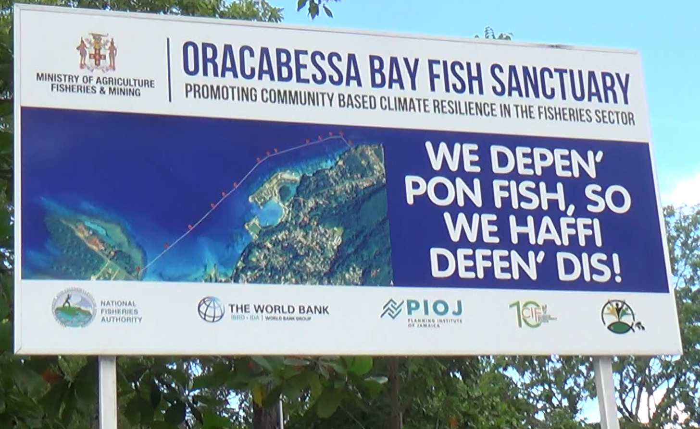
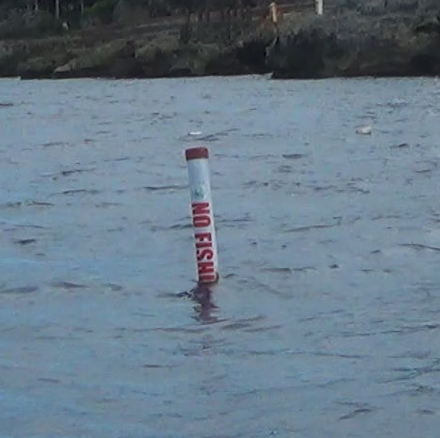
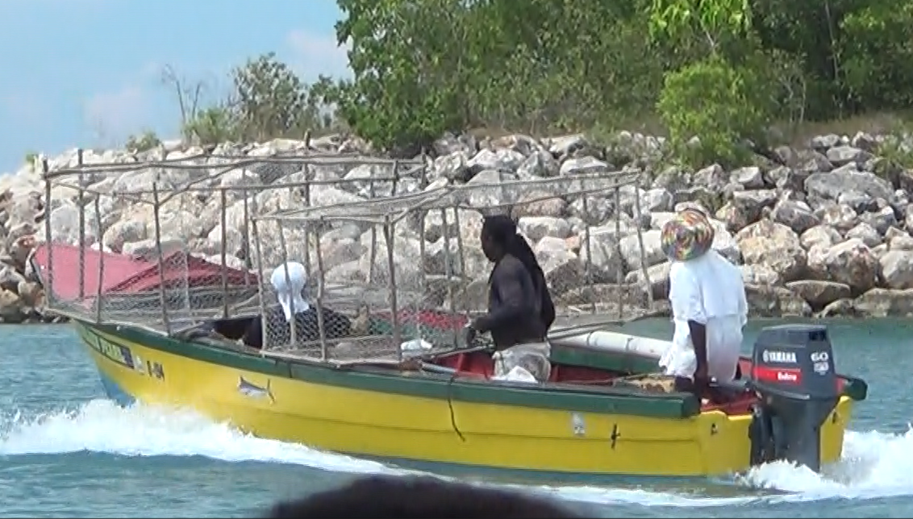
Co-management of marine protected areas and fishing zone in Jamaica
・Local officials, with support from the World Bank, managed a mixed (mosaic) marine protected area adjacent to the fishing area used for trap cage fishing,
・Fishermen do not have to travel far to fishing grounds
・Fishermen catch fish from the sanctuary, theoretically called the sanctuary spill-over effect,
・It is a very interesting system for small-scale fishermen.

Slide 5
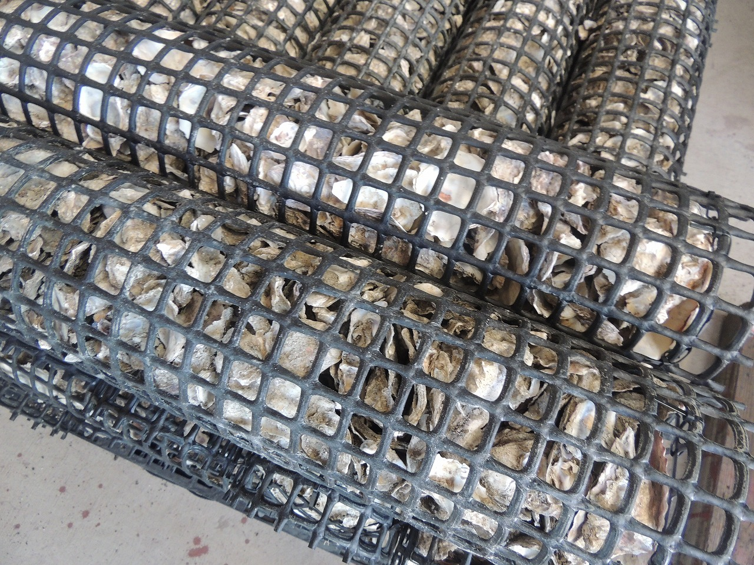
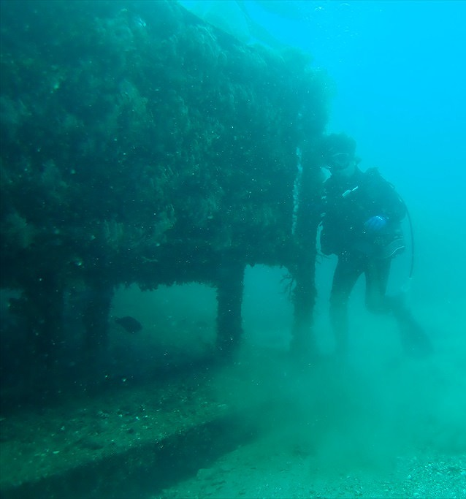
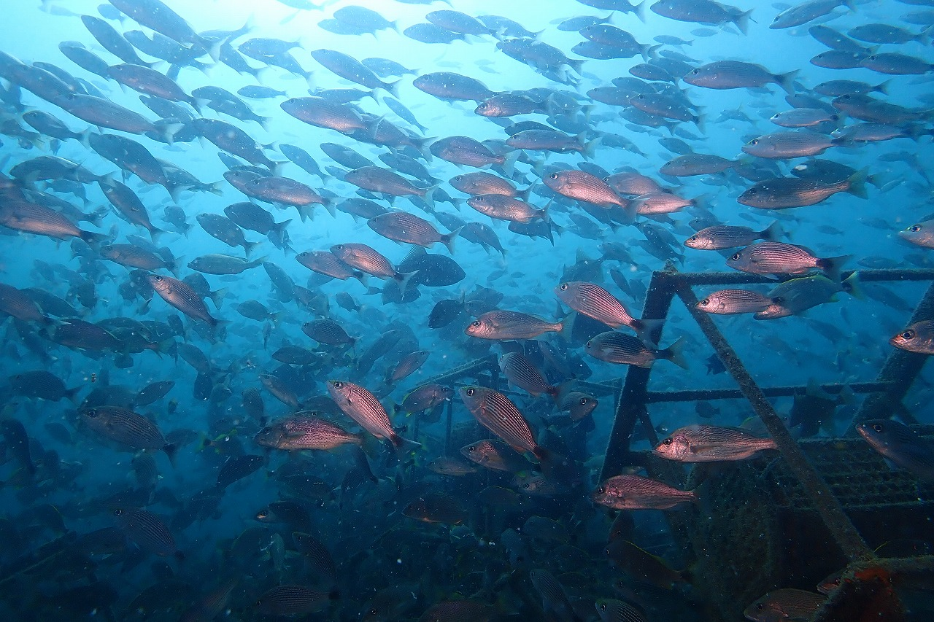
Innovative approach of artificial reefs
・Shell Nurses: Discarded oyster shells are hardened and used as artificial reefs.
・Shells are made into a cubic structure and laid on the seafloor.
・Fish use the reef as a spawning ground, increasing fish biomass.
・It is important to establish a no-take zone around the reefs and allow fishing only outside the no-take zone
Potential for collaboration of domestic production: High interest from overseas organizations; similar initiatives emerging in China, the U.S., and Europe.
Kaiyo Kensetsu - Shellnurse

Slide 6
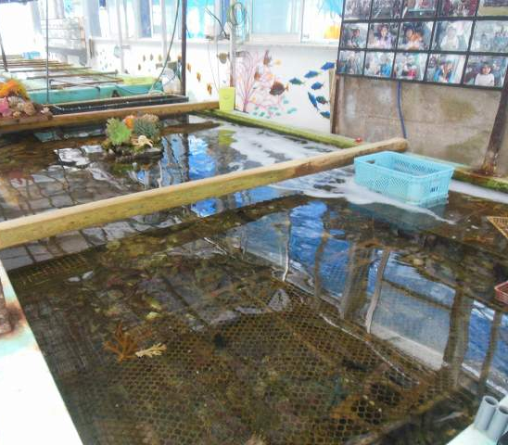
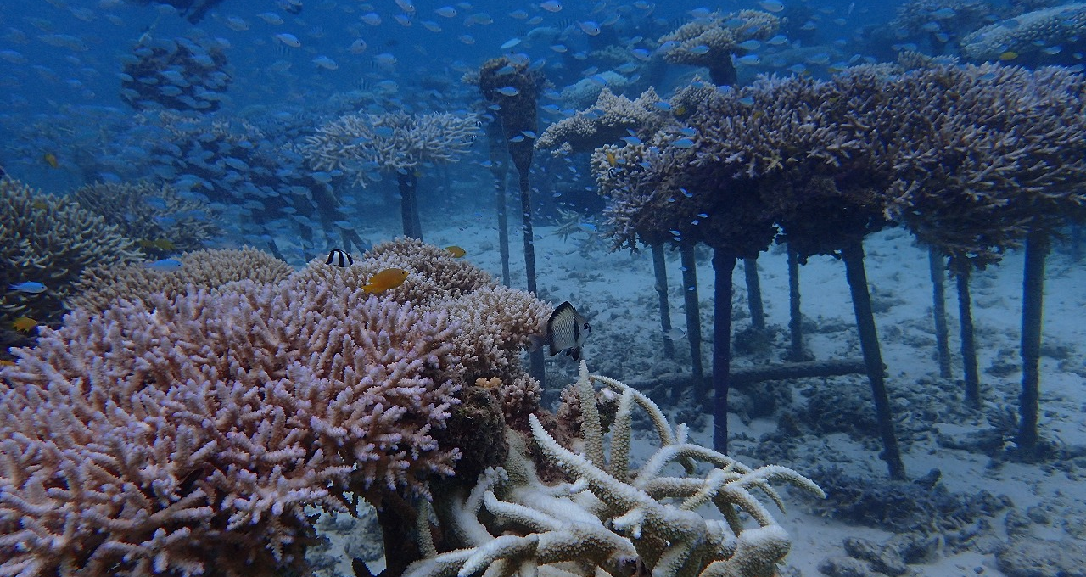
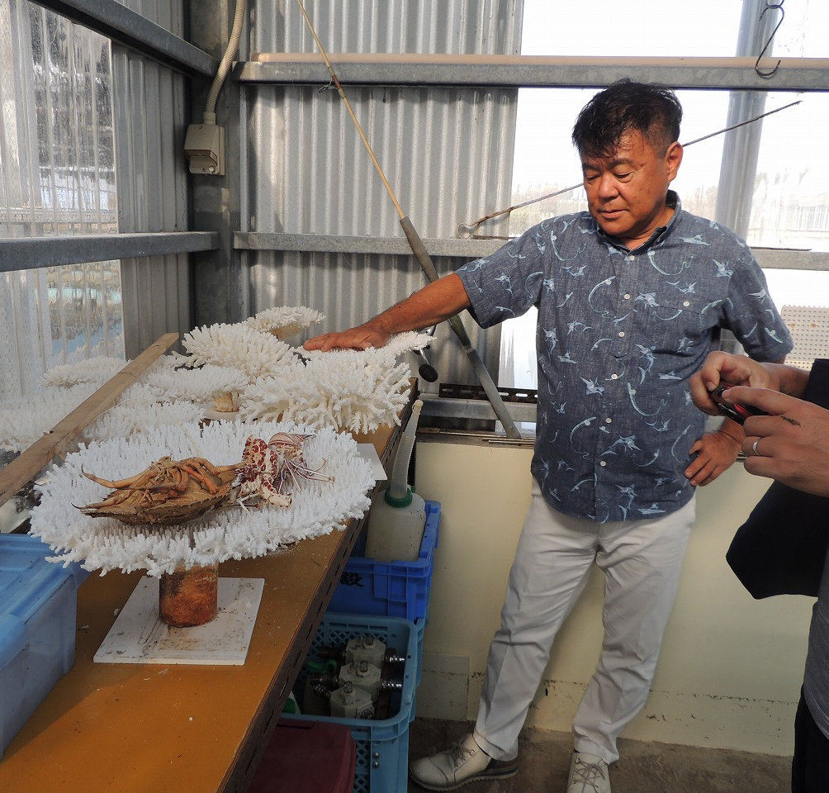
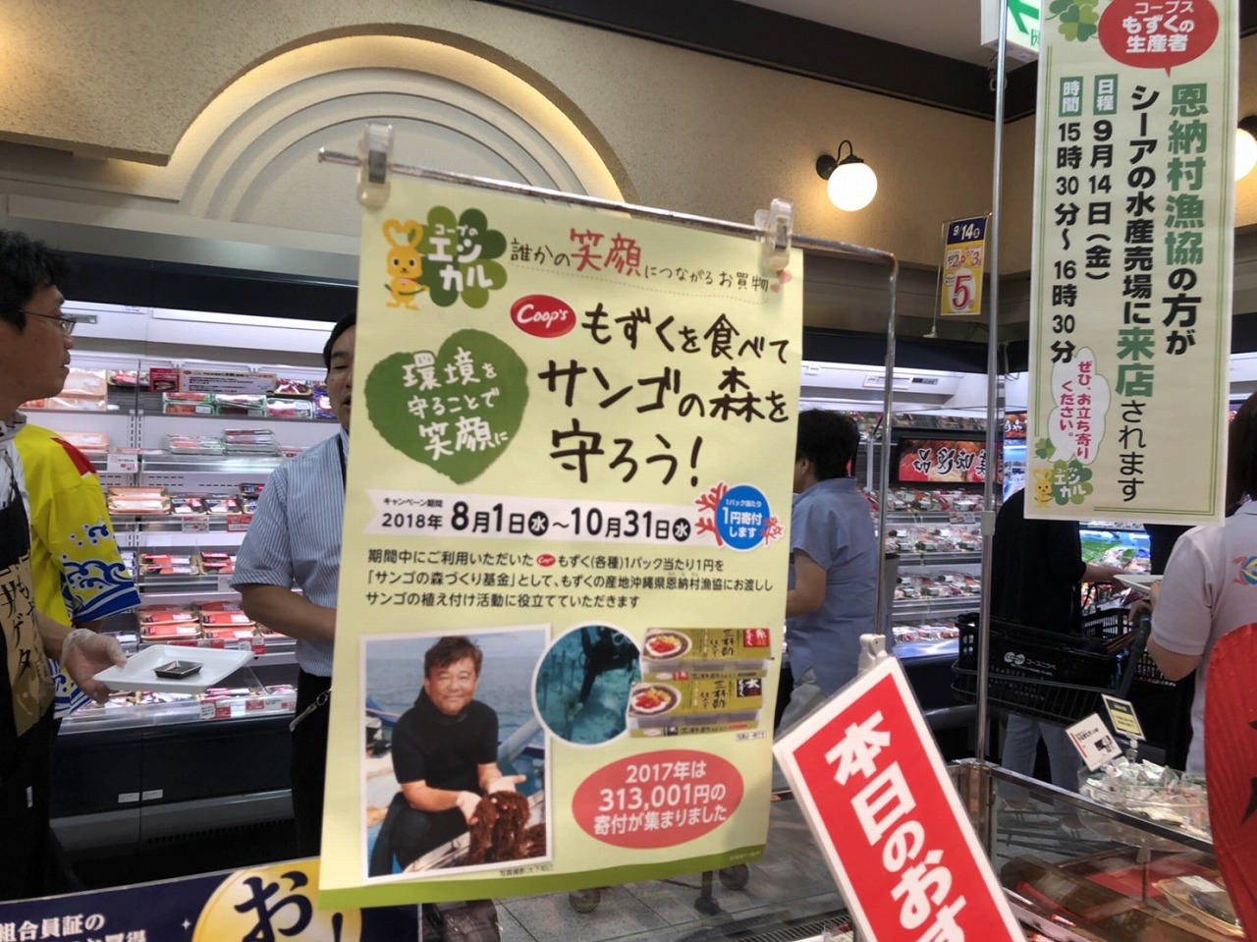
Efforts to Restore Coral Reefs in Onna Village, Okinawa
・Local non-profit organization implements coral rehabilitation efforts.
・Local fishermen support the project.
・A consumer's cooperative donates 1% of mozuku sales to support activities such as coral transplantation.
・Mozuku is a type of seaweed that is low in calories and contains minerals. The mozuku is a type of seaweed that contains low-calorie minerals.
・The Onna Village Office has declared itself a “coral village” and has declared the protection of coral reefs through a variety of measures.
・ANA, together with nine other companies, established “Team Chura Coral” to support the Onna Village Fisheries Cooperative's efforts to restore coral reefs.
Restoration of coral reefs, promotion of tourism, and better understanding of aquaculture
Possible international partnership

Slide 7
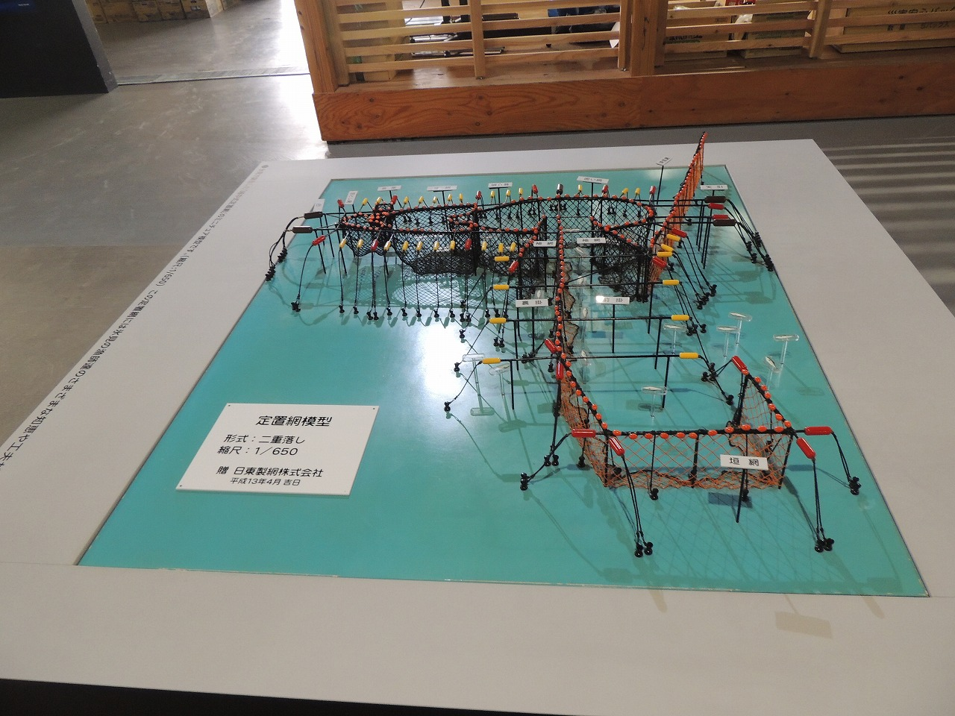
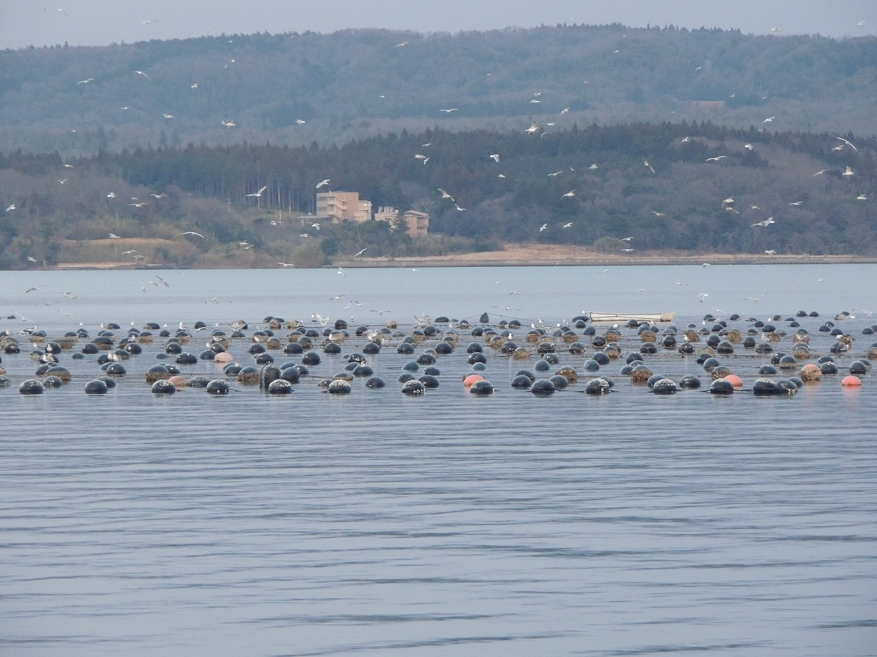
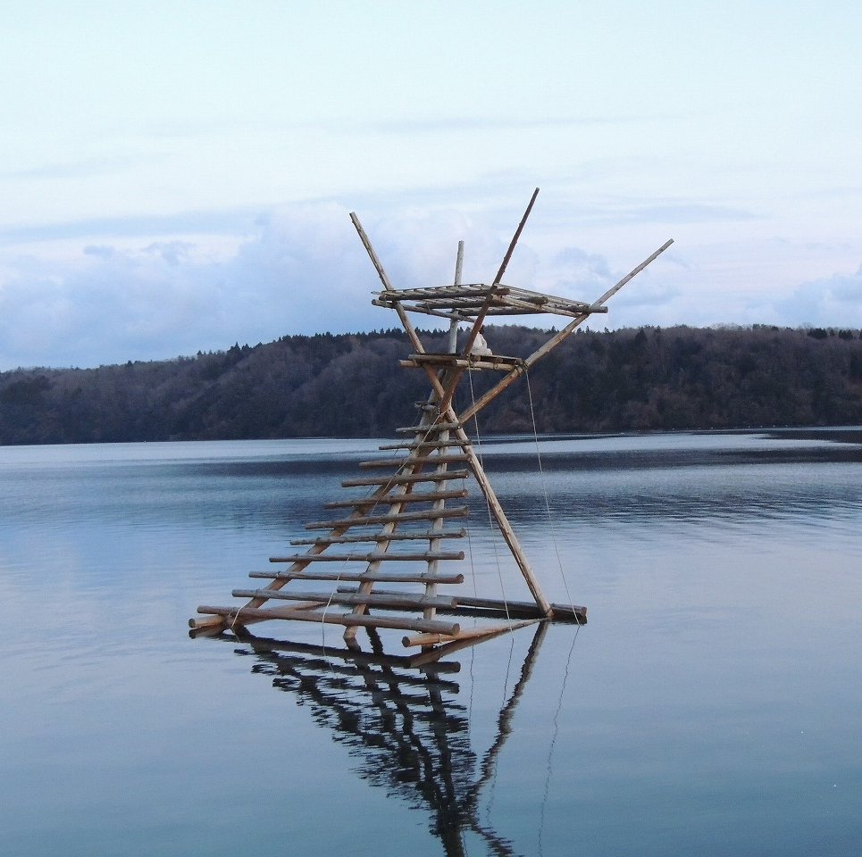
Fix trap fishing net in Toyama
・The set-net fishery in Toyama Bay was recognized as a Japanese Agricultural Heritage in February 2021 as “Sustainable Set-net Fishery in Himi”.
・The fishery has a history of over 400 years and takes advantage of the topography of Toyama Bay.Sustainable fishing methods that do not harm the fish and do not overfish.
・The fishery is linked to the fish-breeding forests and surrounding agriculture, creating a unique seascape and marine coastal zone space.
・Fishing boats do not have to chase fish around, which saves fuel for the vessels. Some fishermen and companies use underwater video cameras to monitor the amount of fish in their nets and to determine when it is time to lift the nets.
・This reduces the amount of fuel used and the time spent on the fishing boat. with DeepL.com (free version)
Possible international partnership
Possible linkages with FAO （GIAHS, Globally Important Agricultural Heritage Systems）
Notes:
https://toyama.uminohi.jp/information/%E7%9C%8C%E5%86%85%E5%88%9D%E6%B0%B7%E8%A6%8B%E5%B8%82%E3%81%AE%E5%AE%9A%E7%BD%AE%E7%B6%B2%E6%BC%81%E6%A5%AD%E3%81%8C%E3%80%8C%E6%97%A5%E6%9C%AC%E8%BE%B2%E6%A5%AD%E9%81%BA%E7%94%A3%E3%80%8D%E8%AA%8D/

Slide 8
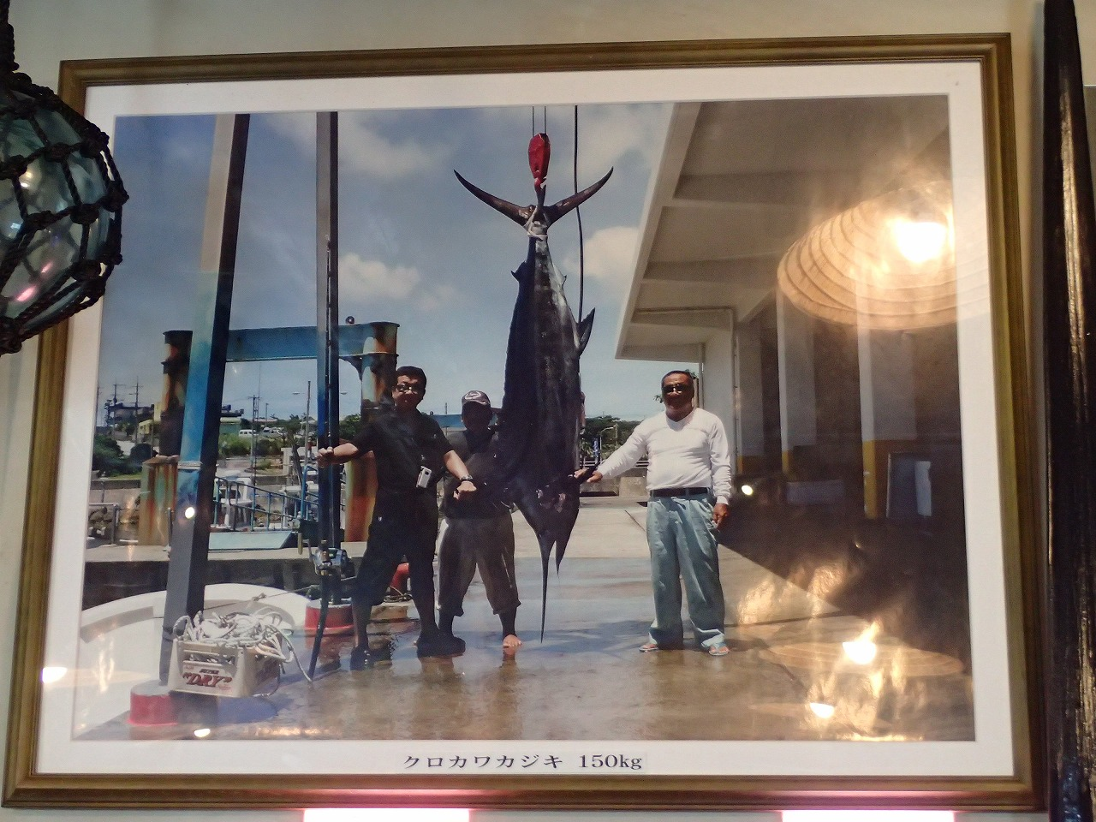
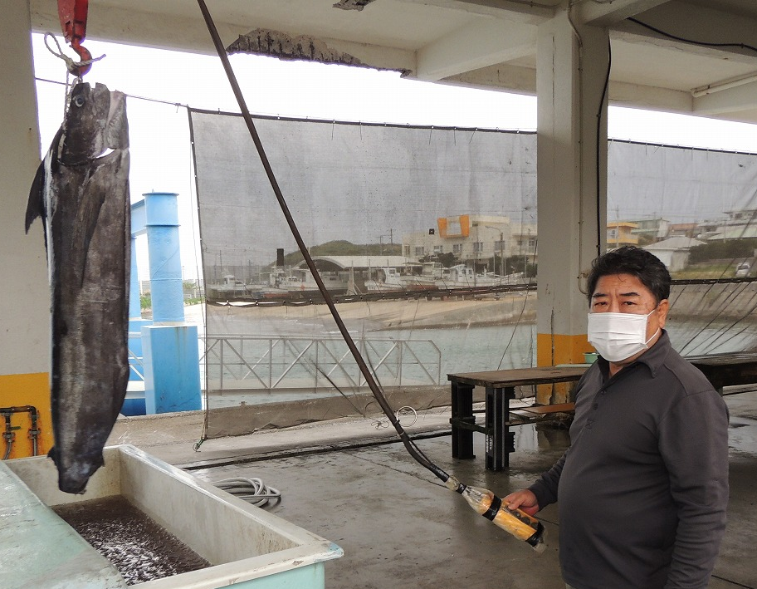
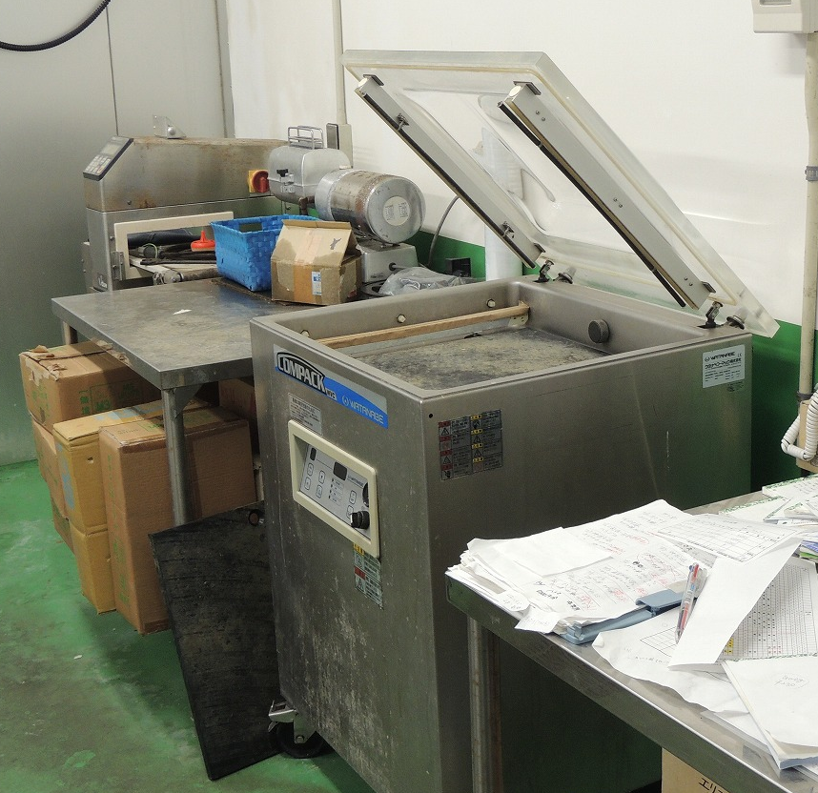
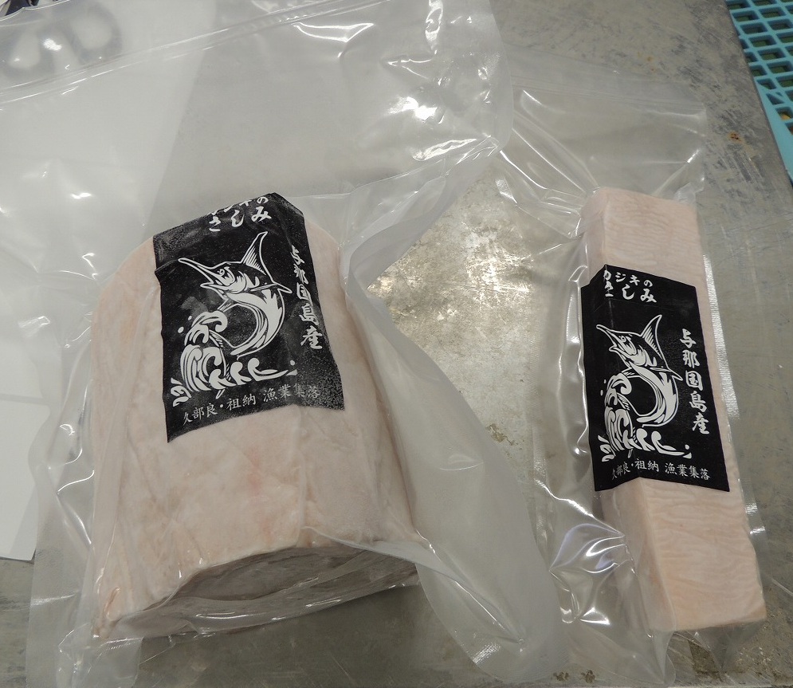
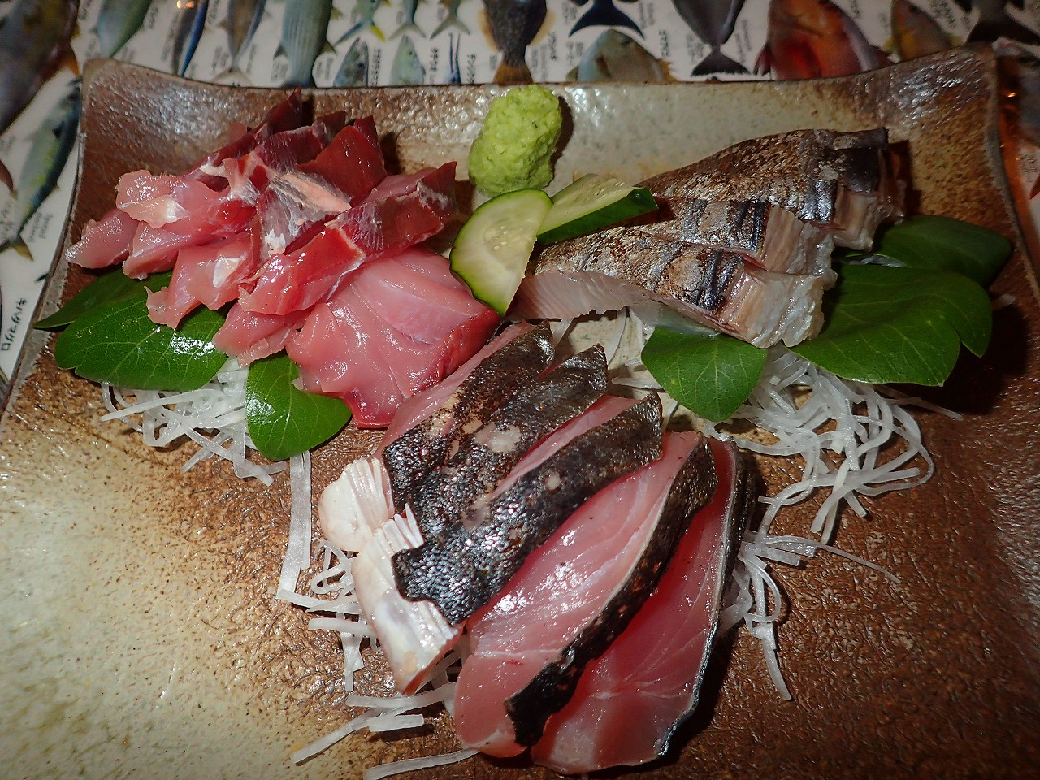
Yonaguni Island, Okinawa Swordfish Tuna Fishing and Tourism Promotion
・Increase the volume of processed swordfish tuna transported to Fukuoka, Osaka, and Tokyo by reducing the number of passenger seats on regularly scheduled flights and increasing cargo space.
・Avoiding flight cancellations even when weather conditions are unfavorable and tourists are declining.Establish a food supply network in Hokuriku for processed kombujime products.
・Organize the Yonaguni Island International Marlin Fishing Tournament on the first weekend of July (Friday, Saturday, and Sunday) every year at the westernmost point of Japan.
・Two divisions, trolling and rock-fishing, compete in the size of the fish caught.In July 2024, 37 teams in the trolling division and 45 anglers in the rock-fishing division will participate in the tournament, with a prize of 100,000 yen for the winner.

Slide 9
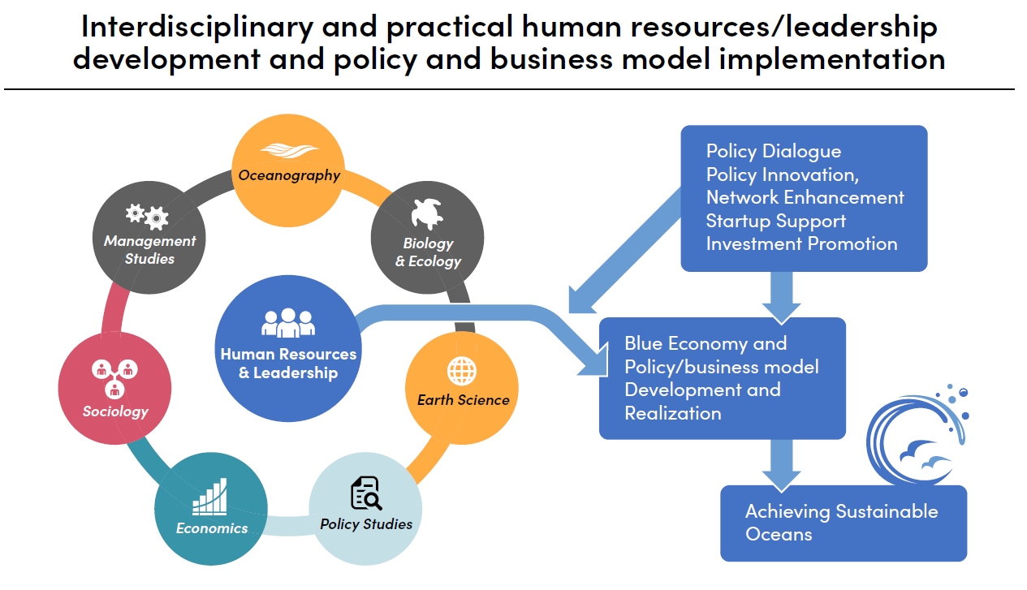

Slide 10
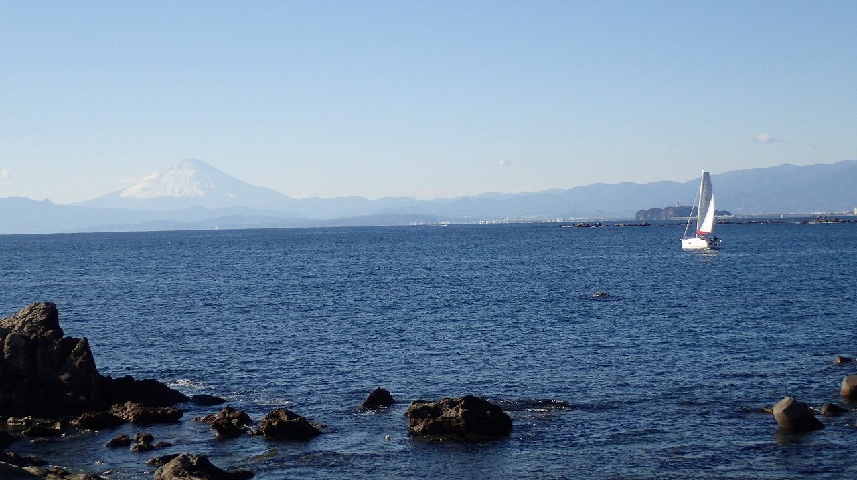
Thank you for your kind attention
m-kobayashi@spf.or.jp

